Slide 1
eCopy ShareScan
Scan to OneDrive
Chris Pearce-King
7 April 2015
V1.3

Slide 2

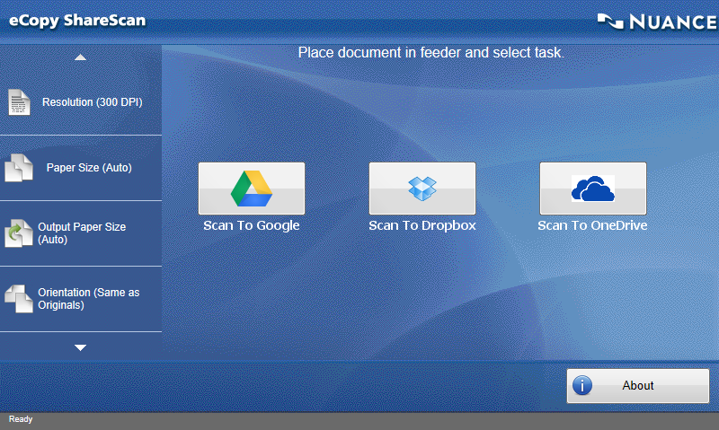
Introducing the eCopy ShareScan Cloud Pack
GAIN CONTROL [ team collaboration ]
Notes:
[speaker notes]
The Cloud Pack Connector for eCopy ShareScan allows documents to be scanned directly from a multifunction or dedicated scanner into a number of Cloud storage services using the eCopy ShareScan 5 frontend.
By using this connector you can authenticate with your existing Google Drive, OneDrive (previously SkyDrive) or Dropbox account and allow users to select which folder to store the scan in.

Slide 3
How it works
The ShareScan CloudPack connector consists of two components - The ShareScan Connector and the Token website.
The cloud storage services all use the oAuth authentication system. This means that to access the cloud systems from anything other than a web browser, the user needs to authorise the application and retrieve a "Token".
The user can do this using the CloudPack Token website.
The token is then used by the application (the ShareScan connector) to authorise the user with the Cloud service.

Slide 4
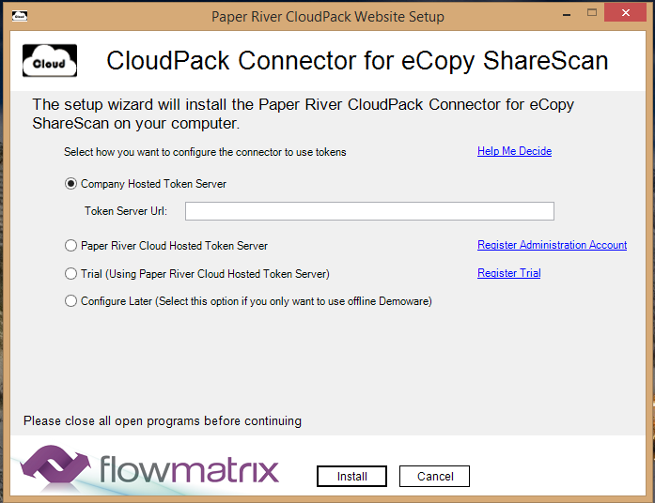
Token options
There are multiple ways in which to deploy / configure the Cloud Pack to use a token sever depending upon the customer preferences.
Company Hosted Token Server
  Select this option if you have installed the accompanying Cloud Pack token website locally within your organisation
Paper River Cloud Hosted Token Server
  Select this option if you have registered to use the Paper River Cloud Token website to host your user tokens.
Trial
  Select this option if you have registered for a trial using the Paper River Cloud Token website.
Configure Later
  Select this option if you want to use the connector in offline demo mode and/or plan to configure the server settings later.
Notes:
Company Hosted Token Server:
Select this option if you have installed the accompanying Cloud Pack token website locally within your organisation
Enter the URL for the website in the "Token Server URL" textbox.
Upon clicking “Install” the connection to the website will be tested, alerting you if the connector was unable to connect.
Paper River Cloud Hosted Token Server
Select this option if you have registered to use the Paper River Cloud Token website to host your user tokens.
Enter the Company ID you were assigned and the Company Password you entered during registration.
Upon clicking “Install” the credentials entered will be tested against the Paper River Cloud Hosted website.
Trial:
Select this option if you have registered for a trial using the Paper River Cloud Token website.
Enter the Pin Code you used when registering for your trial
Upon clicking “Install” the connection to the website and pin code will be tested, alerting you if the connector was unable to connect or could not find your Pin Code.
Configure Later:
Select this option if you want to use the connector in offline demo mode and/or plan to configure the server settings later.

Slide 5
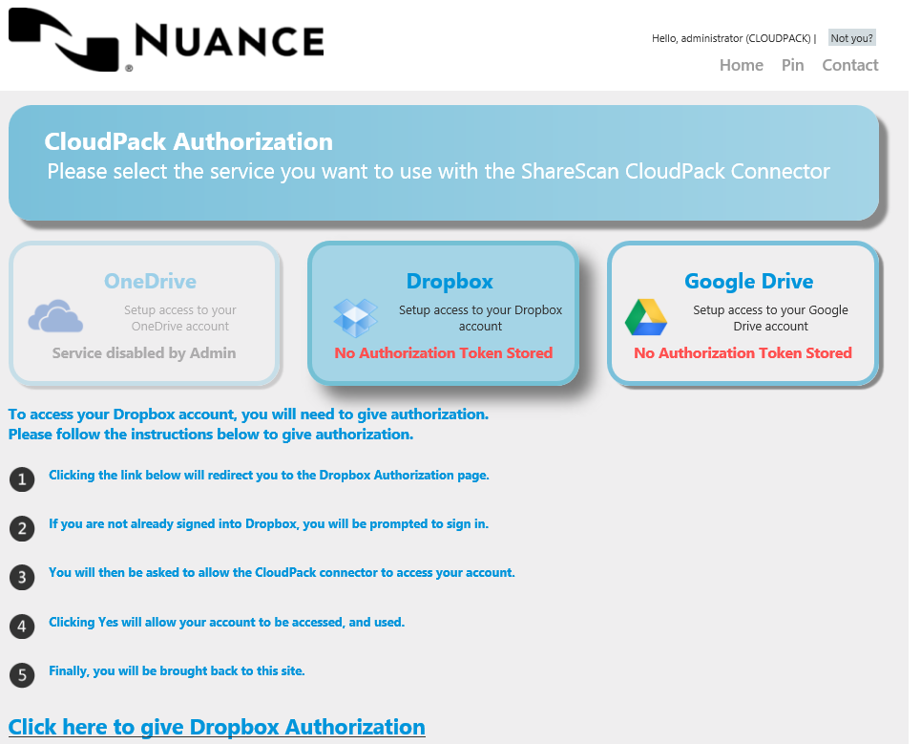
Token authorisation screen
Depending how the administrator has setup the options, you will be presented with one or more options from OneDrive Dropbox and GoogleDrive.
If the administrator has disabled access to a service, it will be greyed out.
If a service says "No Authorisation Token Stored" beneath it, this means you have not yet authorised the service to use the Cloud Pack Connector.
Notes:
You then need to simply follow the instructions shown on the screen. Click on the link, sign in to the cloud service, allow the app the request permissions and you are then returned to the token screen.

Slide 6
Demonstration
Scan to OneDrive

Slide 7
Thank you.

