Slide 1
Top 10 MFDP Pre-Sales Resources
September 2021
Chris Pearce-King
Sr. Manager, Sales Engineering

Slide 2
Faster
Focus
Happier
The purpose of this presentation is to provide a simple guide to the most used Kofax portals by our Partners
Notes:
About This Slide:
Note: Replace statistics in ‘blue’ with expected returns for your customer.
This is the “Impact Slide”. It should help the prospect understand the magnitude of what they are missing out on if they fail to act.
Ideally, this slide should be updated to provide our best estimate to the prospect regarding the benefits that they’re likely to see.
Failing that, we can provide historical estimates from similar customers that are indicative of the prospect’s situation.
Talk Track:
Kofax solutions deliver quality data in the most efficient way possible, allowing your key resources to focus their attention on solving key business challenges (innovating) and delivering extraordinary customer service.
Utilize increased metrics to identify new revenue opportunities and give yourself the competitive edge. Enable the Innovator, get to market faster with new solutions and products offerings.

Slide 3
Top Kofax resources…………..in no particular order
Content
Kofax DocShield
ControlSuite Unified Client Simulator
Kofax Community
Kofax Education Portal
Kofax Partner Portal
Kofax Sales Content Hub
Kofax Resource Centre
Kofax Demo Center
Supported Devices
EuroSales Pre-Sales support desk

Slide 4
1. Kofax DocShield
https://docshield.kofax.com/

Slide 5
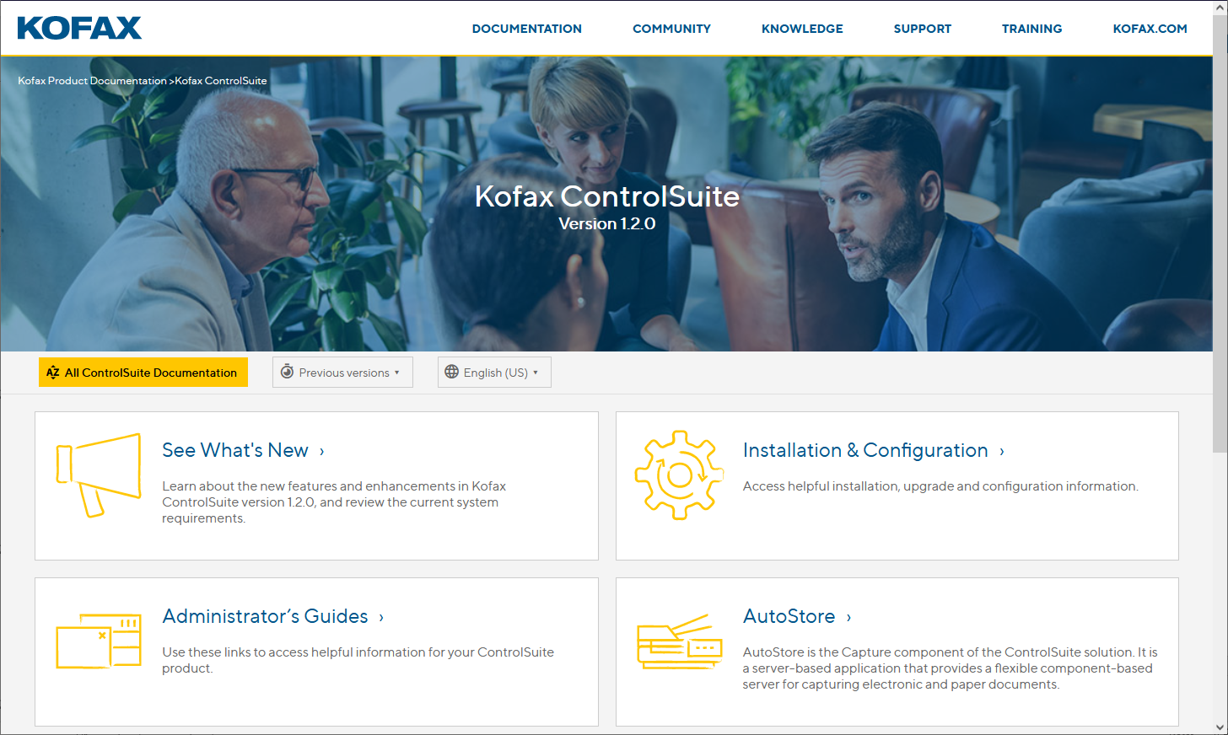
Kofax DocShield
Kofax DocShield provides a single point of access for all our product documentation.

Slide 6
2. ControlSuite Unified Client Simulator
https://smarthub.kofax.com

Slide 7
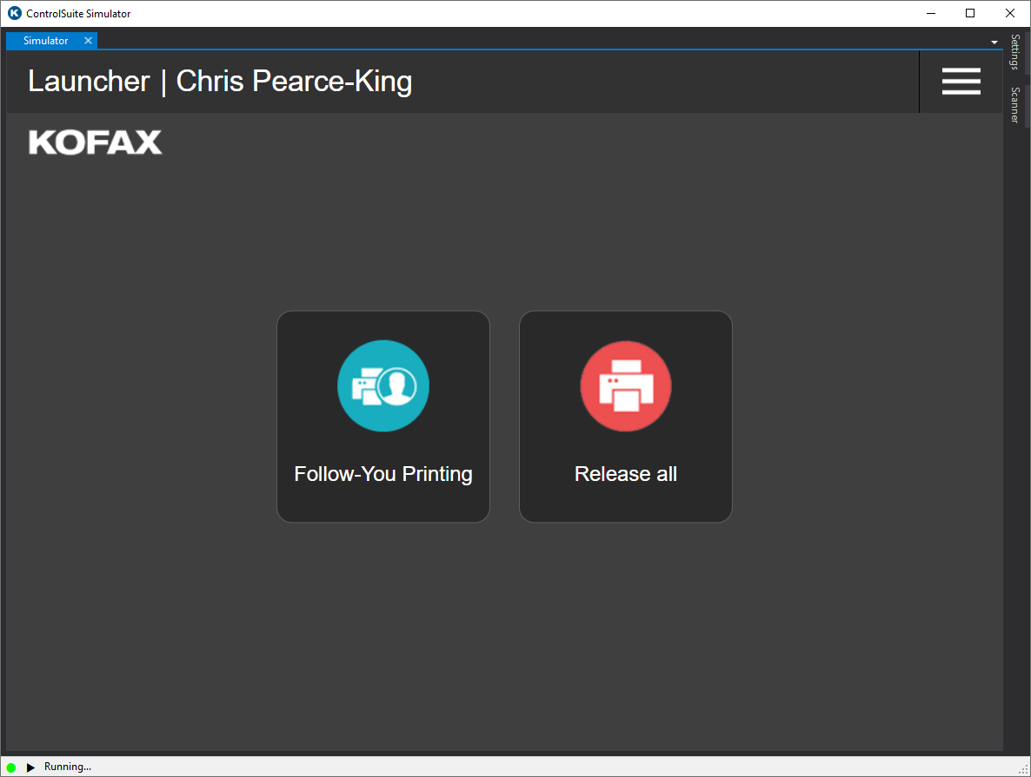
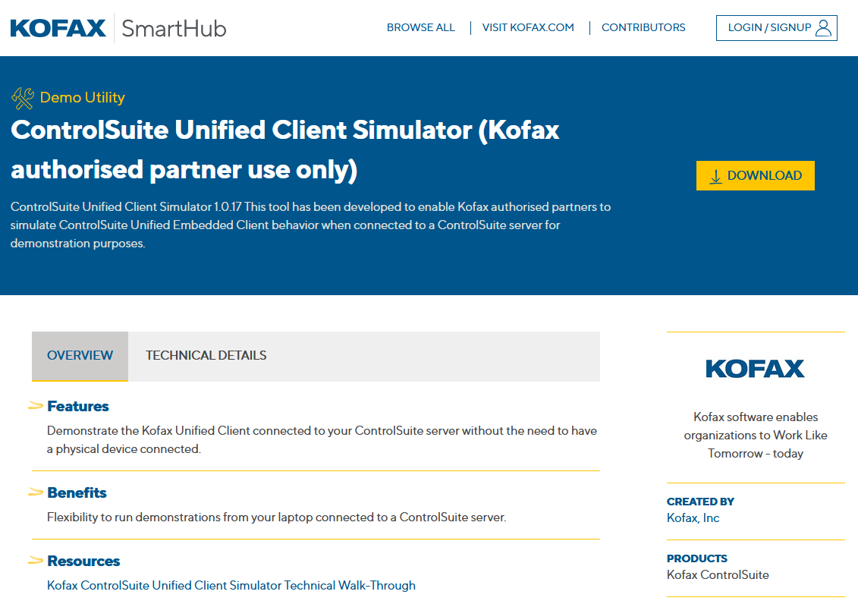
ControlSuite Unified Client Simulator
The ControlSuite Unified Client Simulator is available for partners to download from Kofax SmartHub. Sales Video on Big Tin Can, Technical video on Kofax Demo Center.
Registration is required prior to downloading assets from the site.

Slide 8
3. Kofax Community
https://community.kofax.com

Slide 9
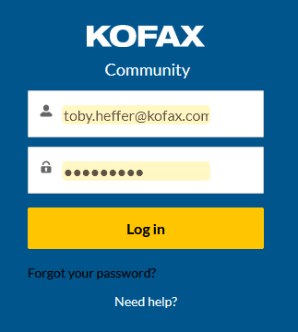
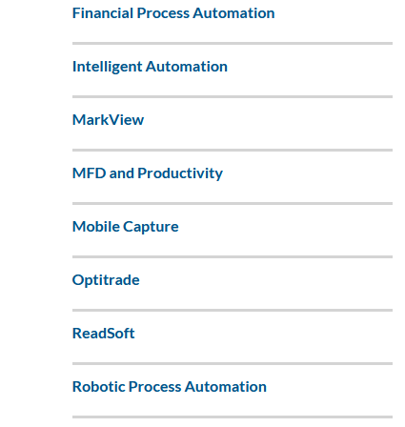
Access to Kofax Community
A Support Portal account is a requirement to have access to the Community portal.
Go to https://community.kofax.com and click MFDP and Productivity.
You will need to log into the Community in order to bookmark articles.

Slide 10
MFD and Productivity Release Announcements
Pinned to the top you will see MFD and Productivity Release Announcements.
Click and Bookmark it. You will then be notified of upcoming product releases.

Slide 11
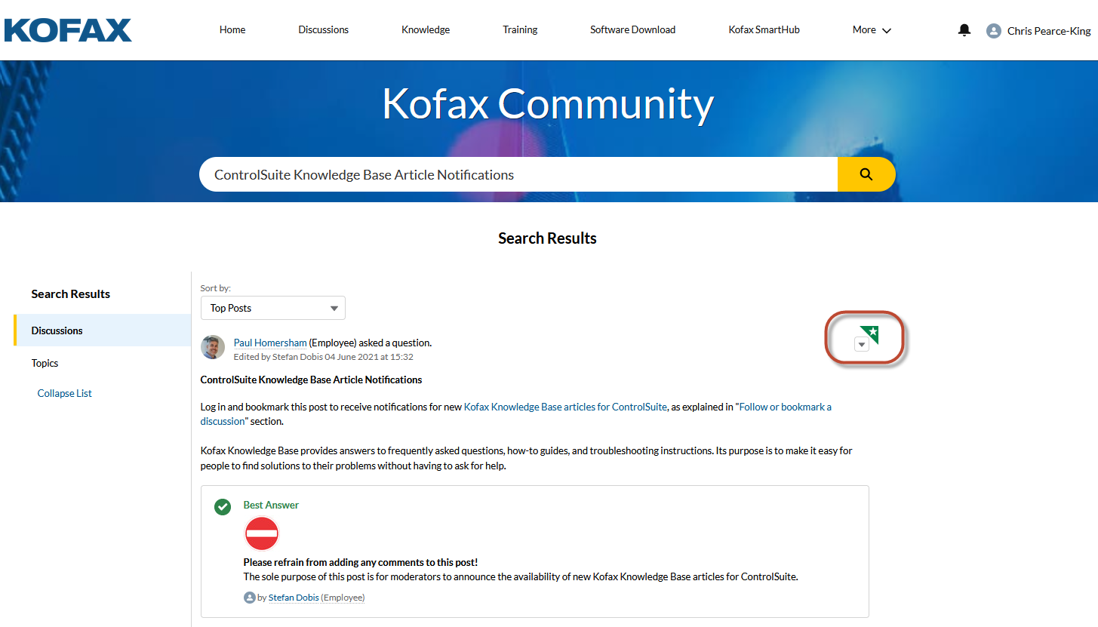
ControlSuite Knowledge Base Article Notifications
Search the Community for “ControlSuite Knowledge Base Article Notifications”.
Bookmark the article below. You will then be notified of new knowledge base articles.

Slide 12
4. Kofax Education Portal
https://learn.Kofax.com

Slide 13
Kofax Education Portal
Here at Kofax we believe that educated partners are the ones most likely to be successful with Kofax products and offer the highest levels of customer service.
The Kofax Training team provide both Sales and Technical curriculums.
Sales Training eLearning courses
Pre-Sales and Technical eLearning courses
MFP specific online training programs.
Our goal is for partners to become as self-sufficient as possible.
Online training is provided for free to Kofax resellers.
To access to go:
https://learn.kofax.com

Slide 14
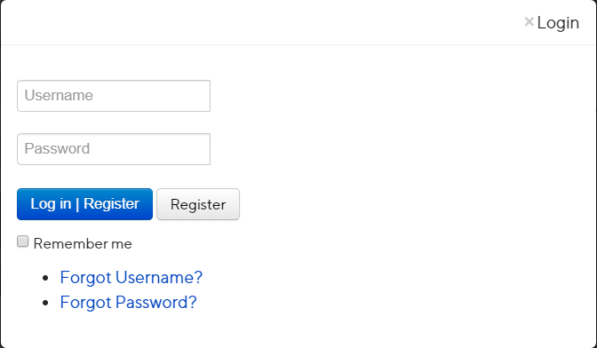
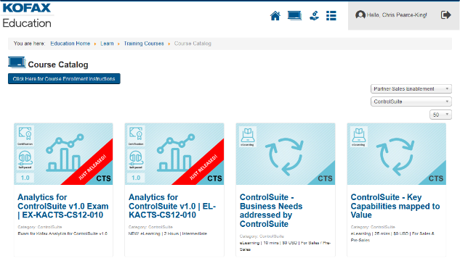
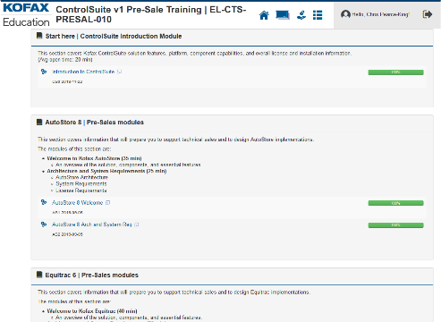
Accessing ControlSuite Pre-Sales Technical eLearning
Go to https://learn.kofax.com.
Click on “Log in | Register”.
Click on “Register” to create an account on the Kofax Education portal or enter your Username and Password and click on “Log in | Register”.
Click on “Training Courses”.
Choose “Partner Sales Enablement” from the fist dropdown and “ControlSuite” from the second dropdown selection.
Hover your mouse on the “Pre-Sale Training” course for ControlSuite, and click on “OPEN COURSE”.
Accept the Terms and Conditions and click on “Subscribe” if asked.
Click on the first module in the “Course Learning Path” to start the Pre-Sales Technical eLearning course.
2
4
3
5
6
8

Slide 15
5. Kofax Partner Portal
https://partner.kofax.com

Slide 16
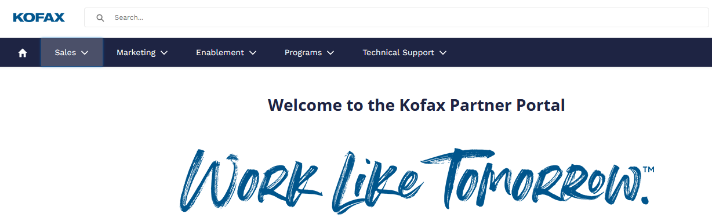
Kofax Partner Portal
The Kofax Partner Portal is a self-service, password-protected, community for Kofax partners. It includes features to assist in managing account information, contacts, lead registration, lead distribution and more.
The Kofax Partner Portal also includes a Content Library offering a comprehensive collection of sales and marketing tools, product information, webinar recordings and technical resources designed to enable our partners to effectively sell and support Kofax solutions.

Slide 17
6. Kofax Sales Content Hub
http://hub.kofax.com

Slide 18
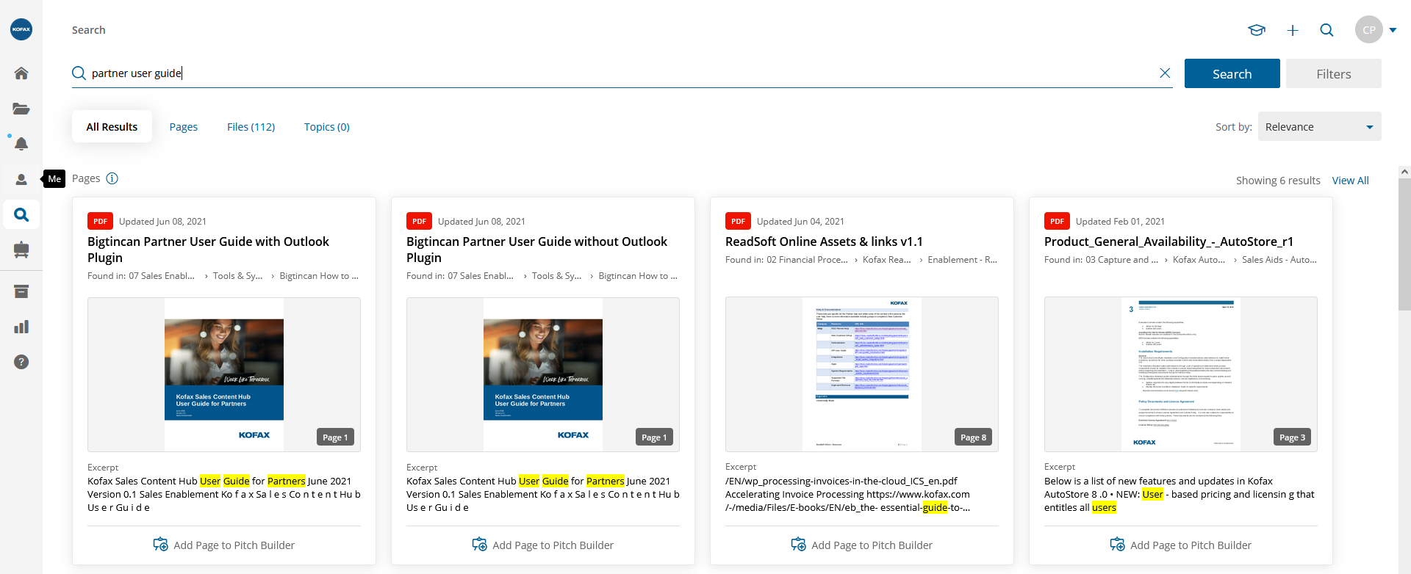
Kofax Sales Content Hub
Kofax provide our partners with access to our Sales Hub.
The Kofax Sales Content Hub (a.k.a. Big Tin Can) is a sales enablement platform that provides content management, collaboration and coaching, sales and marketing alignment, customer engagement, and reporting. The Hub is where you will find, create, and share sales and marketing collateral.
Partners can access the Hub directly from the Kofax Partner Portal. Once logged into the Partner Portal, click Sales in the menu bar and select Sales Content Hub.
Search for Partner User Guide.

Slide 19
7. Kofax Resource Centre
https://www.kofax.com/Learn

Slide 20
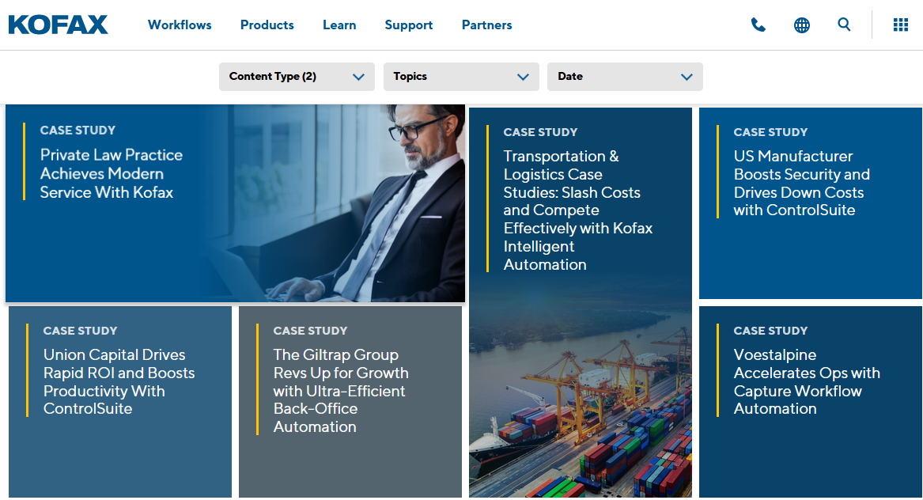
Kofax Resource Centre
The Kofax Resource Centre is where you will find Case Studies, Data Sheets, White Papers, eBooks, Infographics, Videos and more.

Slide 21
8. Kofax Demo Center
https://www.kofaxdemocenter.com

Slide 22
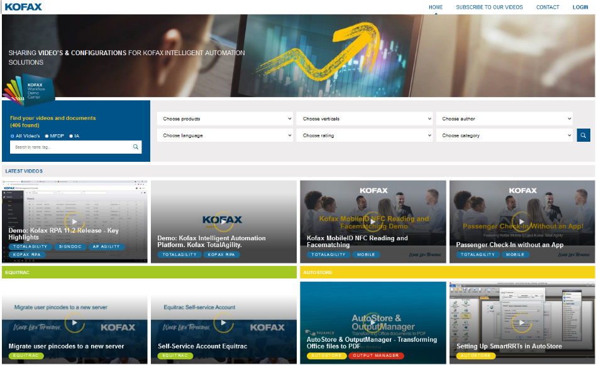
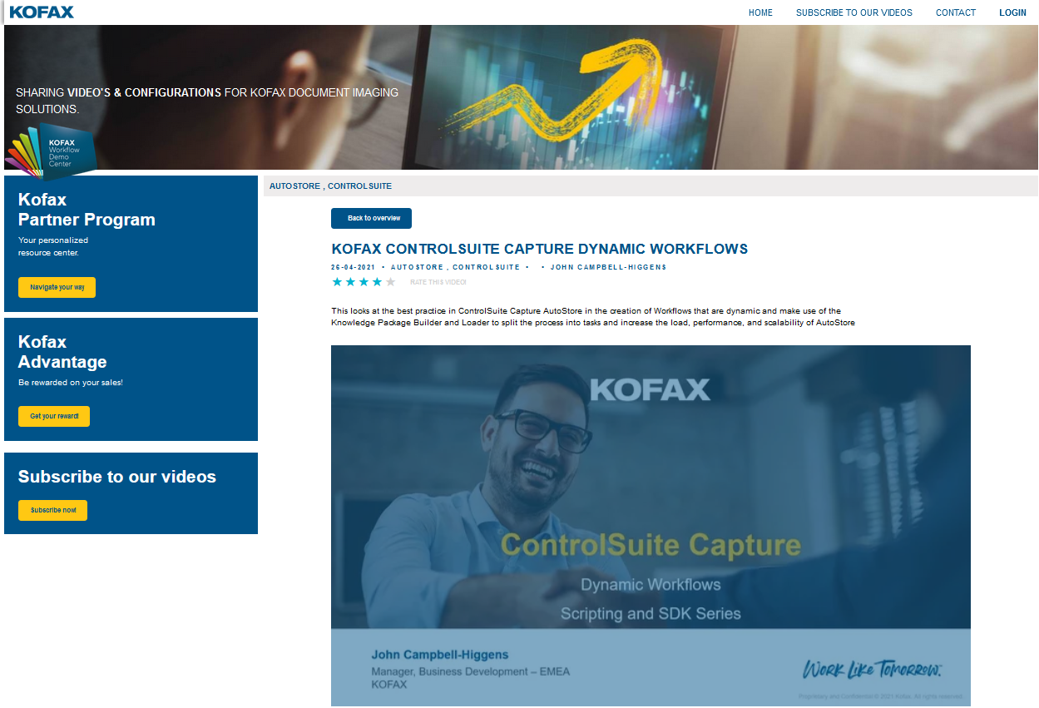
Kofax Demo Center
Access technical videos recorded by Kofax Sales Engineers that show how you can Work Like Tomorrow™- today with Kofax solutions. Many of the videos have attachments and configuration scripts you can use to recreate the specific workflows for your customers.

Slide 23
9. Supported Devices
https://knowledge.kofax.com/MFD_Productivity/00_Supported_Devices/Supported_Devices

Slide 24
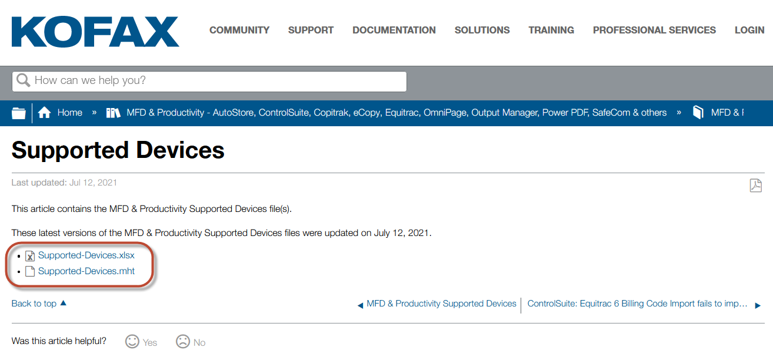
Supported Devices
Kofax maintain a downloadable list of all the supported devices across the MFDP product range. The spreadsheet contains filters to quickly check if a specific device is supported for use with a specific Kofax product.

Slide 25
10. EuroSales
EMEA Pre-Sales Support Desk

Slide 26
EMEA Pre-Sales Service Desk - eurosales@kofax.com
Across EMEA we operate a manned Pre-Sales support desk called EuroSales which is an email response service. This service is staffed to support EMEA partners only. For regions outside of EMEA, please contact your local Sales Engineering team.
EuroSales is to back up our regional SE team (who are field-based) and for handling advanced Pre-Sales questions across all the core Kofax (formerly NDI) products.
Typically responses are addressed within minutes however some questions may require further investigation or need to be rerouted to another department.
EuroSales is manned by EMEA SE’s via a daily rota (excluding Wednesdays).
All Partners must be technically certified on the relevant product to access EuroSales and the service is in English language only.

